Slide 1
PROFESSOR VELAZQUEZ
INTRODUCTION
TO
MICROECONOMICS
MODULE 12 · POLICY, PARADOX AND HUMAN PERSPECTIVES
FALL 2025

Slide 2
12
Policy, Paradox and
Human Perspectives
You have travelled 5,000 years of economic history and mastered the core toolkit. This module completes the argument: the full taxonomy of market failure and the policy instrument matched to each; the ways human beings systematically depart from the models; and the paradoxes economics reveals about its own limits. Then we return the course question to you.
MODULE

Slide 3
MODULE 12
Agenda, Big Questions & Opening Inquiry
BIG QUESTIONS
PRE-WORK
WHAT YOU'LL NEED
(1) What is the complete taxonomy of market failures — and what is the appropriate policy instrument for each type?
(2) What paradoxes and limitations does economics reveal about its own framework — and what lies beyond GDP as a measure of human flourishing?
(3) Having completed this course, how would you answer the question posed in Module 1?
· Read Chapters 10–11 (Externalities; Public Goods and Common Resources)
· Review Module 4 (surplus and DWL), Module 7 (asymmetric information), Module 8 (climate distribution) and Module 11 (game theory) — all four return today
· Bring the Module 12 Worksheet, a calculator and graph paper
· Bring your Module 1 answer to the course question
· Module 12 Worksheet (printed)
· Calculator for the Pigouvian tax and incidence arithmetic
· Graph paper — four labeled diagrams today
· Your written course thesis, drafted before the second half of class
OPENING INQUIRY
"Why do markets sometimes fail to allocate resources in ways that promote human flourishing — and what, if anything, should be done about it?" You first met this question in Module 1, with no tools. Today you answer it with all of them.
SECTION I — WELFARE ECONOMICS | SECTION II — HUMAN PERSPECTIVES | SECTION III — PARADOX & THESIS
Part 1 · Types of goods; the six common market problems Part 2 · Externalities: Pigouvian tax and subsidy, Coase, cap-and-trade Part 3 · Tax incidence and dynamic policy design Part 4 · Climate Arc Part 3 — evaluating the full policy menu | Part 5 · Behavioral economics: Allais, Ellsberg, loss aversion, nudges, administrative burden Part 6 · Social interaction: public goods games, the ultimatum game, fairness | Part 7 · The SMD paradox, the Solow paradox, Arrow's theorem, the Gödel analogy · Wellbeing beyond GDP: Sen and the HDI · The course thesis, returned
INTRO TO MICROECONOMICS | PROF. VELAZQUEZ
MODULE 12: POLICY, PARADOX & HUMAN PERSPECTIVES

Slide 4
BEFORE WE BEGIN
Vocabulary Checklist — Module 12
☐ Market Failure (taxonomy)
☐ Externality
☐ Public Goods
☐ Common Resources
☐ Asymmetric Information
☐ Government Failure
☐ Policy Instruments
☐ Pigouvian Tax
☐ Coase Theorem
☐ Cap-and-Trade
☐ Universal Basic Income
☐ Progressive Taxation
☐ Public vs. Market Provision
☐ Carbon Pricing
☐ Carbon Dividend
☐ Path Dependence
☐ Bounded Rationality
☐ Loss Aversion
☐ Framing Effects
☐ Administrative Burden
☐ Paradox of Value
☐ Paradox of Thrift
☐ Sen's HDI
☐ Wellbeing Economics
☐ SMD Paradox
☐ Solow Paradox
☐ Arrow's Impossibility
☐ Agency & Structural Change
HOW TO USE THIS LIST
This is the longest vocabulary list of the course because it is the SYNTHESIS module. Terms in columns 1–4 are analytical tools; columns 5–7 are the critiques of those tools. You need both to write the thesis.
INTRO TO MICROECONOMICS | PROF. VELAZQUEZ
MODULE 12: POLICY, PARADOX & HUMAN PERSPECTIVES

Slide 5
SECTION I
Welfare Economics, Part 2
Part 1 · Types of goods and the six common problems of market economies
Part 2 · Externalities: the Pigouvian tax and subsidy, the Coase theorem, cap-and-trade
Part 3 · Tax incidence and dynamic policy design — time, adjustment and path dependence
Part 4 · Climate Arc, Part 3 — evaluating the full menu of instruments

Slide 6
1
Types of Goods & Market Failure
PART
OBJECTIVE Classify goods by rivalry and excludability, identify the six recurring market problems, and match each market failure to its canonical policy instrument.
INTRO TO MICROECONOMICS | PROF. VELAZQUEZ
MODULE 12: POLICY, PARADOX & HUMAN PERSPECTIVES

Slide 7
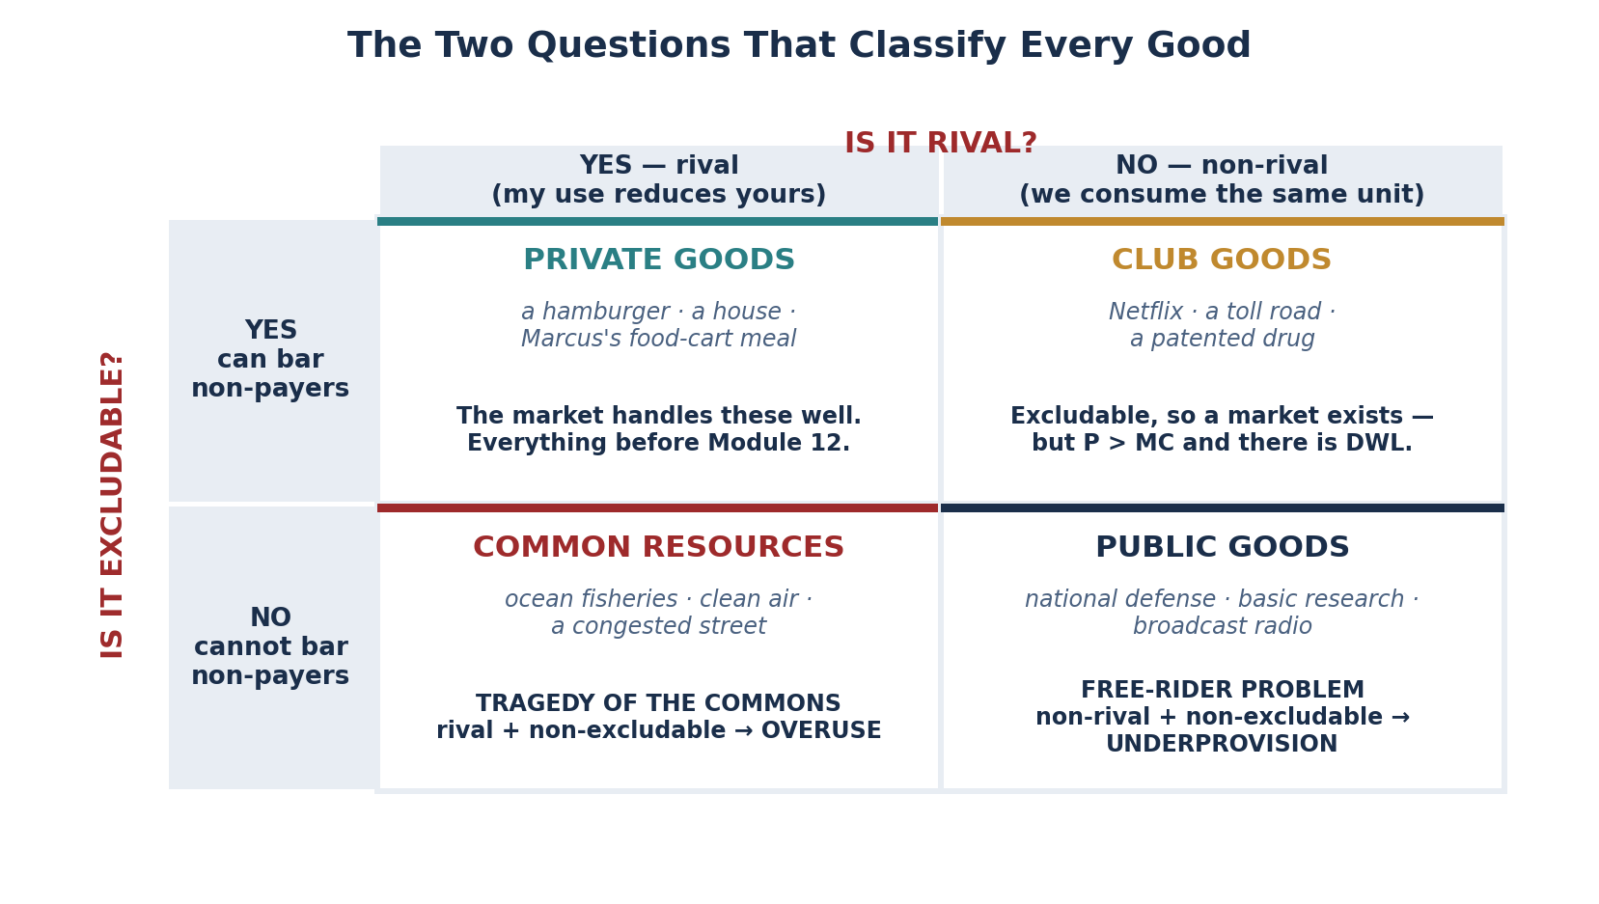
PART 1 · THE TWO PROPERTIES
Rivalry and Excludability
RIVALRY
EXCLUDABILITY
A good is RIVAL if one person's consumption reduces the amount available to everyone else. My eating the sandwich means you cannot eat it.
NON-RIVAL goods can be consumed by any number of people at once, at zero marginal cost per additional user.
A good is EXCLUDABLE if the seller can prevent people who have not paid from consuming it. A ticket, a fence, a paywall, a lock.
NON-EXCLUDABLE goods cannot practically be withheld from non-payers once provided at all.
WHY THESE TWO PROPERTIES, AND NO OTHERS
Every result in Modules 3 through 11 quietly assumed BOTH. Rivalry is what makes a supply curve meaningful — if my consumption costs you nothing, there is no scarcity to allocate. Excludability is what makes a demand curve revealed — if I can consume without paying, my willingness to pay is never expressed in a price.
Remove either property and the price mechanism stops carrying the information it is supposed to carry. That is the whole of market failure, stated in one sentence.
MARKET FAILURE = the price does not equal the true social marginal value
Every instrument in this module is an attempt to put that back.
INTRO TO MICROECONOMICS | PROF. VELAZQUEZ
MODULE 12: POLICY, PARADOX & HUMAN PERSPECTIVES

Slide 8
PART 1 · THE SIX COMMON PROBLEMS
What Goes Wrong, and Why
PROBLEM | MECHANISM | PRECISE EXAMPLE | FIRST MET IN
TRAGEDY OF THE COMMONS | Rival + non-excludable. Each user bears the full private benefit of one more unit of use but only a fraction of the congestion cost imposed on everyone. Use exceeds the sustainable level. | Ocean fisheries; a congested street; the atmosphere's capacity to absorb CO₂ | Module 6, Module 8
FREE-RIDER PROBLEM | Non-rival + non-excludable. Because a non-payer cannot be excluded, each person's dominant strategy is to consume without paying — so no private firm can recover its costs. | National defense; basic scientific research; a lighthouse | Module 11 (game theory)
ADVERSE SELECTION | Hidden TYPE, known before the transaction. The uninformed side prices for the average, which drives the above-average quality out of the market, which lowers the average again. | Akerlof's used-car lemons market; individual health insurance | Module 7, Part 4
MORAL HAZARD | Hidden ACTION, taken after the transaction. Because the actor does not bear the full cost of the risk, more risk is taken than either party would have agreed to ex ante. | Insured drivers; 2008 mortgage originators who sold the loan on | Module 7, Part 4
PRINCIPAL–AGENT | One party decides on another's behalf, and their interests diverge. The agent optimizes their own objective, not the principal's. | Executives vs. shareholders; brokers vs. clients | Module 7, Part 4
SIGNALING & SCREENING | When the information asymmetry is not fixed directly, the market spends real resources proving what could have been simply disclosed. | Costly credentialing; warranties; extensive interview processes | Module 7, Part 4
THE ORGANIZING DISTINCTION
The first two problems come from the NATURE OF THE GOOD — rivalry and excludability. The last four come from the NATURE OF THE INFORMATION — who knows what, and when. Different sources, different remedies: the first pair needs public provision or a use limit; the second needs disclosure, verification, or a contract that aligns incentives.
INTRO TO MICROECONOMICS | PROF. VELAZQUEZ
MODULE 12: POLICY, PARADOX & HUMAN PERSPECTIVES

Slide 9
PART 1 · THE MASTER TABLE
Market Failure → Policy Instrument
MARKET FAILURE | WHY MARKETS FAIL | PRECISE EXAMPLE | CANONICAL POLICY INSTRUMENT
NEGATIVE EXTERNALITY | Third-party costs are not priced | Carbon emissions (M6, M8) | PIGOUVIAN TAX or CAP-AND-TRADE
POSITIVE EXTERNALITY | Third-party benefits are not compensated | Basic research; vaccines; schooling | PIGOUVIAN SUBSIDY, public provision, or a patent
PUBLIC GOODS | Non-rival + non-excludable → free riding | National defense; NIH-funded basic research; flood control | PUBLIC PROVISION financed by compulsory taxation
COMMON RESOURCES | Rival + non-excludable → overuse | Atlantic cod; groundwater aquifers; road congestion | QUOTAS or tradable use rights; congestion pricing; Ostrom-style local governance
ASYMMETRIC INFORMATION | One party holds private information | The lemons market (Akerlof, M7) | MANDATED DISCLOSURE, certification, warranties, mandatory pooling
MARKET POWER (MONOPOLY) | P > MC → deadweight loss (M11) | AT&T before 1984; a patented drug; default search placement | ANTITRUST ENFORCEMENT or rate-of-return regulation
GOVERNMENT FAILURE | The intervention creates its own distortion | The 1990 luxury tax; rent control's long-run supply effect (M4); regulatory capture | SUNSET CLAUSES, independent evaluation, competitive procurement
THE HARDEST ONE TO CORRECT
GLOBAL COMMON RESOURCES — the climate case. It is the only failure on this list with NO ENFORCING AUTHORITY. Every other row assumes a government with jurisdiction over both the polluter and the harmed party. For carbon, the emitter and the victim are in different countries, the harm is deferred by decades, and no institution can compel compliance — so the Prisoner's Dilemma of Module 11 has no external enforcer to change the payoffs.
INTRO TO MICROECONOMICS | PROF. VELAZQUEZ
MODULE 12: POLICY, PARADOX & HUMAN PERSPECTIVES

Slide 10
PART 1 · WORKSHEET CLASSIFICATION
Classify Each Good
GOOD | RIVAL? | EXCLUDABLE? | CLASSIFICATION & PROVISION PROBLEM
National defense | No | No | PUBLIC GOOD — free-rider problem; no private firm can charge for it, so it must be tax-financed
Marcus's food-cart meal | Yes | Yes | PRIVATE GOOD — no provision problem; the market allocates it efficiently
Public park (uncrowded) | No | No (usually) | PUBLIC GOOD while uncrowded. Note the boundary is about CONGESTION, not the park
Congested city street | YES | No | COMMON RESOURCE — the same physical asset became rival once crowded. Tragedy of the commons; the remedy is congestion pricing
Broadcast radio signal | No | No | PUBLIC GOOD — the textbook case. Funded by advertising, licence fee, or donation, never by charging listeners
Fish in an unregulated sea | Yes | No | COMMON RESOURCE — overfishing; the remedy is a catch quota or an individual transferable quota
COVID-19 vaccine (when scarce) | Yes | Yes | PRIVATE GOOD in consumption — but with a LARGE POSITIVE EXTERNALITY, so the market underprovides at the socially optimal price
THE FREE-RIDER PROBLEM, STATED PRECISELY
WHY THE MARKET UNDERPROVIDES
A rational agent consumes a public good without paying because their own contribution is neither NECESSARY nor SUFFICIENT for provision: if others fund it, they enjoy it anyway; if others do not, their single contribution will not deliver it. Non-payment is a dominant strategy — not a moral failing.
Competitive firms cannot EXCLUDE non-payers, so they cannot recover their fixed costs however much the good is worth. Willingness to pay is never revealed as a price. Provision therefore falls to zero — not to a lower level, but to zero — even when total social benefit far exceeds total cost.
INTRO TO MICROECONOMICS | PROF. VELAZQUEZ
MODULE 12: POLICY, PARADOX & HUMAN PERSPECTIVES

Slide 11
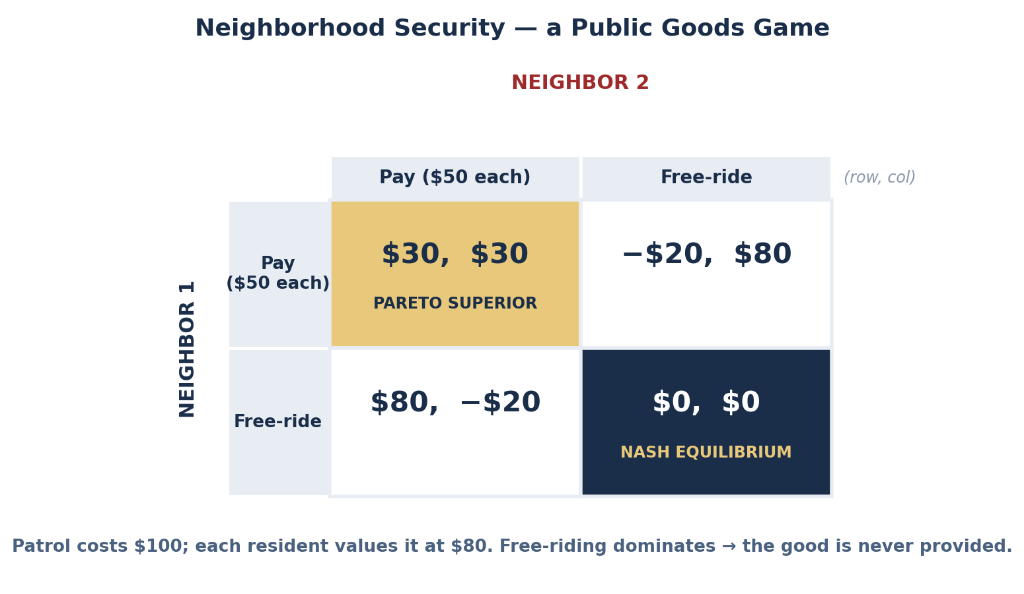
SCENARIO · NEIGHBORHOOD SECURITY
The Free-Rider Problem as a Game
WORKSHEET BLANK | ANSWER
Payoff if Marcus contributes AND others contribute | $80 value − $50 share = +$30
Payoff if Marcus free-rides AND others contribute | $80 value − $0 = +$80
Marcus's dominant strategy (regardless of others) | FREE-RIDE. If others pay, 80 > 30. If they don't, 0 > −20.
Nash equilibrium of the public goods game | (Free-ride, Free-ride) = ($0, $0) — no security is provided
Justification for provision through taxation | Taxation is COMPULSORY, which removes the free-ride option from the strategy set. It does not persuade people to cooperate; it changes the game so that defection is unavailable.
✦3 THE SAME GAME AT PLANETARY SCALE
Each country's dominant strategy is not to abate. The mechanisms that could produce cooperation are exactly Module 11's: repetition with observable compliance, credible punishment, and changing the payoffs directly. International institutions supply the first two — regular conferences, transparency and review, reputational cost — but they cannot supply the third, which is why border carbon adjustments (a domestic penalty for foreign defection) matter so much.
INTRO TO MICROECONOMICS | PROF. VELAZQUEZ
MODULE 12: POLICY, PARADOX & HUMAN PERSPECTIVES

Slide 12
PART 1 · DISCUSSION
✦1 and ✦2 — Working the Two Hard Questions
✦1 NOT WHETHER, BUT WHICH — AND AT WHAT SCALE
✦2 BASIC RESEARCH AS A PUBLIC GOOD
This is the correct framing, and it is not a centrist evasion. Every market already rests on a legal architecture — property, contract, tort — that government created; 'no intervention' is not one of the options. The real question is comparative institutional analysis: is the market failure larger than the government failure that correcting it would introduce?
CLEARLY WARRANTED: a negative externality with a measurable marginal damage, a single jurisdiction, and low administrative cost — leaded gasoline, or SO₂ under the 1990 Act. The failure is large, the instrument is cheap, and the counterfactual is documented.
LIKELY NOT WORTH IT: occupational licensing for low-risk trades — hair braiding, floristry, interior design. The stated failure is asymmetric information about quality; the actual effect is an entry barrier that raises incumbents' wages and reduces employment, with no measurable safety benefit.
A theorem, once proved, is perfectly non-rival and — absent legal restriction — non-excludable. A private firm capturing only a fraction of the social return invests only up to that fraction. The estimated social return to basic R&D is roughly 30–50% annually; the private return is far lower. That gap IS the underinvestment.
THE TWO MODELS: government provision (NSF, NIH) funds the work directly and places the output in the public domain — efficient in use, but it requires the funder to pick the projects. The PATENT model creates ARTIFICIAL EXCLUDABILITY: it fixes underinvestment by manufacturing a monopoly, trading the Module 11 deadweight loss for the incentive to invent.
EQUITY: public provision spreads the cost across taxpayers and the benefit across everyone. The patent model concentrates the cost on the people who need the product most — a patented drug's burden falls on the sick.
A TEST FOR ANY PROPOSED INTERVENTION | ASK
1. Is there an identifiable market failure, named from the taxonomy? | Which row of the master table is this?
2. Is the instrument matched to the mechanism? | A price failure needs a price fix; an information failure needs disclosure
3. Is the government's information good enough to set the parameter? | Can we actually measure the marginal external cost?
4. Who bears the burden, and is that the intent? | Incidence, not statutory obligation — see Part 3
5. What happens if it is wrong, and can it be reversed? | Sunset clauses, pilots, independent evaluation
INTRO TO MICROECONOMICS | PROF. VELAZQUEZ
MODULE 12: POLICY, PARADOX & HUMAN PERSPECTIVES

Slide 13
2
Externalities
PART
OBJECTIVE Model positive and negative externalities formally, derive and compute the Pigouvian tax and subsidy, and evaluate the three instruments for internalizing an external cost: taxation, bargaining and tradable permits.
INTRO TO MICROECONOMICS | PROF. VELAZQUEZ
MODULE 12: POLICY, PARADOX & HUMAN PERSPECTIVES

Slide 14
PART 2 · FORMAL DEFINITIONS
Negative and Positive Externalities
NEGATIVE EXTERNALITY
POSITIVE EXTERNALITY
A cost imposed on a third party who is neither the buyer nor the seller, and who is not compensated for it.
FORMAL: SMC > PMC. The supply curve reflects only what the producer pays; the true social cost lies above it by the marginal external cost.
MARKET RESULT: the firm OVERPRODUCES. Output stops where PMB = PMC, which lies to the right of where PMB = SMC.
POLICY: a PIGOUVIAN TAX equal to the marginal external cost. The tax raises the firm's effective PMC to the SMC, so the private optimum becomes the social optimum.
A benefit conferred on a third party who neither buys nor sells, and who does not pay for it.
FORMAL: SMB > PMB. The demand curve reflects only the buyer's private benefit; the true social benefit lies above it.
MARKET RESULT: the firm UNDERPRODUCES. Output stops where PMB = PMC, to the left of where SMB = PMC.
POLICY: a PIGOUVIAN SUBSIDY equal to the marginal external benefit. It shifts effective demand up to the SMB curve so buyers act on the full social benefit.
TAX AND REDUCE
SUBSIDIZE AND PRODUCE
Rule of thumb for a negative externality — Pigou (1920)
Rule of thumb for a positive externality
WHY A PRICE CONTROL CANNOT DO THIS JOB
In Module 4 you used price ceilings and floors. They cannot fix an externality, and the reason is precise: a price control targets the EQUILIBRIUM PRICE, while an externality is a defect in the MARGINAL COST or MARGINAL BENEFIT SCHEDULE. A ceiling on the price of a polluting good moves the market along the wrong curve; the gap between PMC and SMC is untouched, and the quantity typically moves the wrong way.
Pigou's insight is that price-based correction must target the MARGINAL EXTERNALITY, not the price level. This is why the tax is set per unit of the external damage, not as a percentage of the sale price.
INTRO TO MICROECONOMICS | PROF. VELAZQUEZ
MODULE 12: POLICY, PARADOX & HUMAN PERSPECTIVES

Slide 15
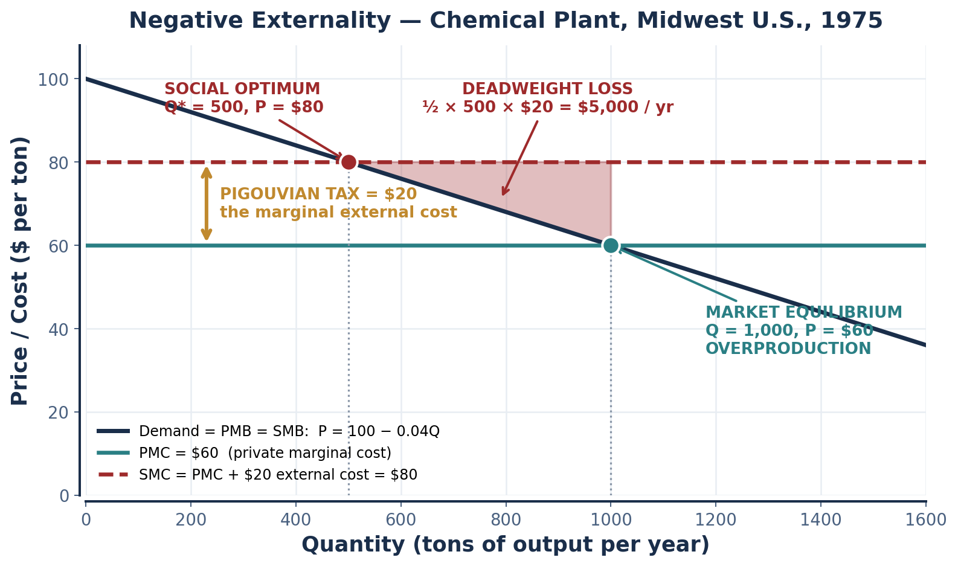
SCENARIO · CHEMICAL PLANT, MIDWEST U.S., 1975
Computing the Pigouvian Tax
STEP | WORK | ANSWER
1. Identify the externality | SMC = PMC + external = $60 + $20 | SMC = $80/ton
At Q = 1,000 | SMC = $80 vs. P = $60 — society pays more than the buyer | NEGATIVE externality → OVERPRODUCTION
2. Deadweight loss | ½ × (1,000 − 500) × $20 | DWL = $5,000 per year
3. Pigouvian tax | Tax = marginal external cost | $20 per ton
After the tax | Effective PMC = $60 + $20 = $80; produce until P = $80 | Q = 500 = Q* ✓
4. Tax revenue | $20 × 500 tons | $10,000 per year
Use of revenue | Compensate river users; fund abatement R&D; or cut a distorting tax elsewhere | —
A NOTE ON THE DEMAND CURVE
The worksheet gives P = $80 at the optimum and P = $60 at the market equilibrium with Q = 1,000 and Q* = 500. Those four numbers imply exactly one linear demand curve: P = 100 − 0.04Q. That is the curve drawn here, and every figure above follows from it.
INTRO TO MICROECONOMICS | PROF. VELAZQUEZ
MODULE 12: POLICY, PARADOX & HUMAN PERSPECTIVES

Slide 16
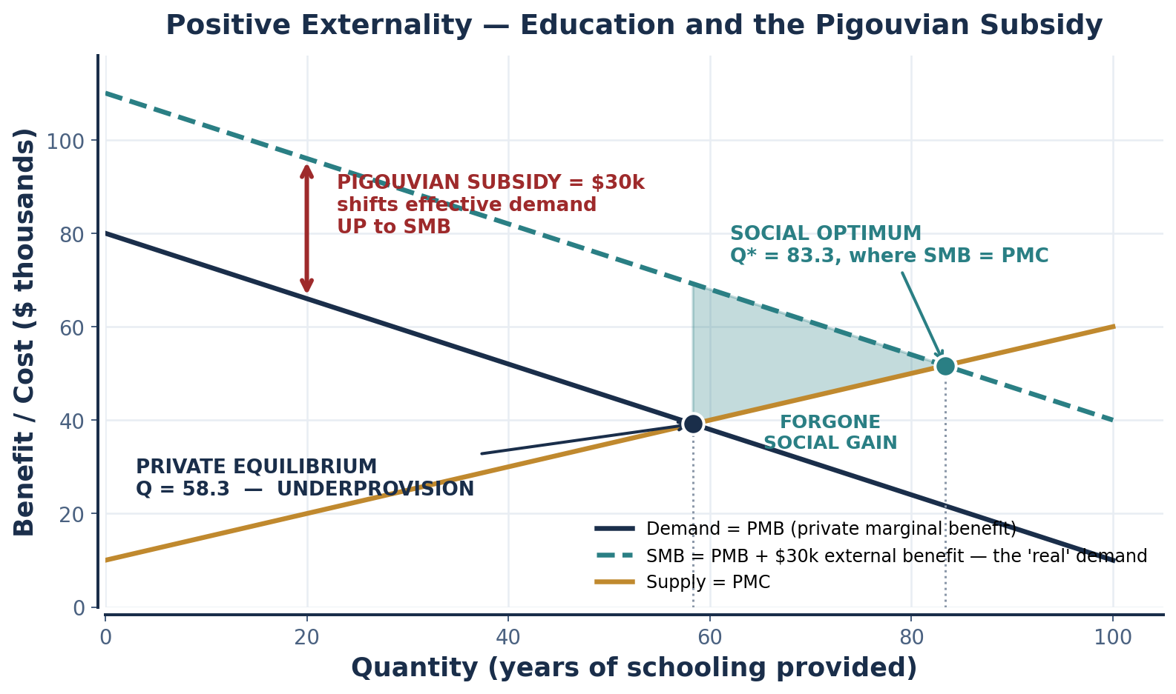
PART 2 · THE MIRROR IMAGE
Positive Externality and the Pigouvian Subsidy
THE HISTORICAL CASE — OPERATION WARP SPEED, 2020
A vaccine has an enormous positive externality: my immunity protects you. A developer captures only buyers' private willingness to pay, so the private return badly understates the social one — and manufacturing before trials conclude risks destroying doses it never sells.
The U.S. committed roughly $10 billion in ADVANCE PURCHASE COMMITMENTS and at-risk manufacturing — a Pigouvian subsidy in its most literal form.
THE FOUR WAYS TO FIX A POSITIVE EXTERNALITY | COST TO WHOM
Pigouvian subsidy to buyers — vouchers, tax credits | Taxpayers; visible in the model as a demand shift
Producer subsidy — direct funding to suppliers | Taxpayers; shifts effective supply down
Direct public provision | Taxpayers; requires the state to choose the quantity
Mandate — require the behavior, with a penalty | The regulated party; no budget cost, but regressive in incidence
THE EDUCATION EXAMPLE
Schooling's private benefit is higher lifetime earnings. Its external benefits — lower crime, better civic function, higher coworker productivity — accrue to people who never paid tuition.
INTRO TO MICROECONOMICS | PROF. VELAZQUEZ
MODULE 12: POLICY, PARADOX & HUMAN PERSPECTIVES

Slide 17
PART 2 · THREE INSTRUMENTS
Tax, Bargain, or Cap — and When Each Works
INSTRUMENT | MECHANISM | EFFICIENCY CONDITION | EQUITY CONCERN
PIGOUVIAN TAX | Set a price per unit equal to the marginal external cost; the firm internalizes it and chooses Q* itself | Requires an accurate estimate of the social cost. Sets the PRICE and lets the quantity fall where it may | Regressive in direct burden unless the revenue is recycled
COASE THEOREM | Assign a clear property right and let the affected parties BARGAIN to the efficient outcome — no regulator needed | Requires well-defined property rights, near-zero transaction costs, costless bargaining and full information | WHO HOLDS THE RIGHT determines the distribution of the gains, even though the efficient quantity is the same either way
CAP-AND-TRADE | Fix the total QUANTITY as tradable permits; the market discovers the price at which the cap is met | Achieves any given target at least cost, because permits flow to whoever finds abatement most expensive. Sets the QUANTITY and lets the price fall where it may | The initial allocation of permits distributes a windfall — grandfathering hands it to incumbent polluters; auctioning returns it to the public
THE COASE THEOREM — AND WHERE IT BREAKS
COASE'S REAL POINT
Coase was not arguing that government should stay out. He was arguing that the externality is RECIPROCAL — the factory harms the laundry only because the laundry is there — and that the right question is which assignment of rights produces the lower total cost, INCLUDING the cost of bargaining. Where transaction costs are high, that comparison usually favors regulation. 'The Problem of Social Cost' is read as a libertarian text far more often than it deserves.
Coase (1960): if property rights are WELL DEFINED and transaction costs are LOW, private parties bargain to the efficient allocation with no government action — and the efficient QUANTITY is the same whoever holds the right.
It breaks with MANY PARTIES, ASYMMETRIC INFORMATION, POWER ASYMMETRY or HIGH MONITORING COSTS — all four true of carbon.
INTRO TO MICROECONOMICS | PROF. VELAZQUEZ
MODULE 12: POLICY, PARADOX & HUMAN PERSPECTIVES

Slide 18
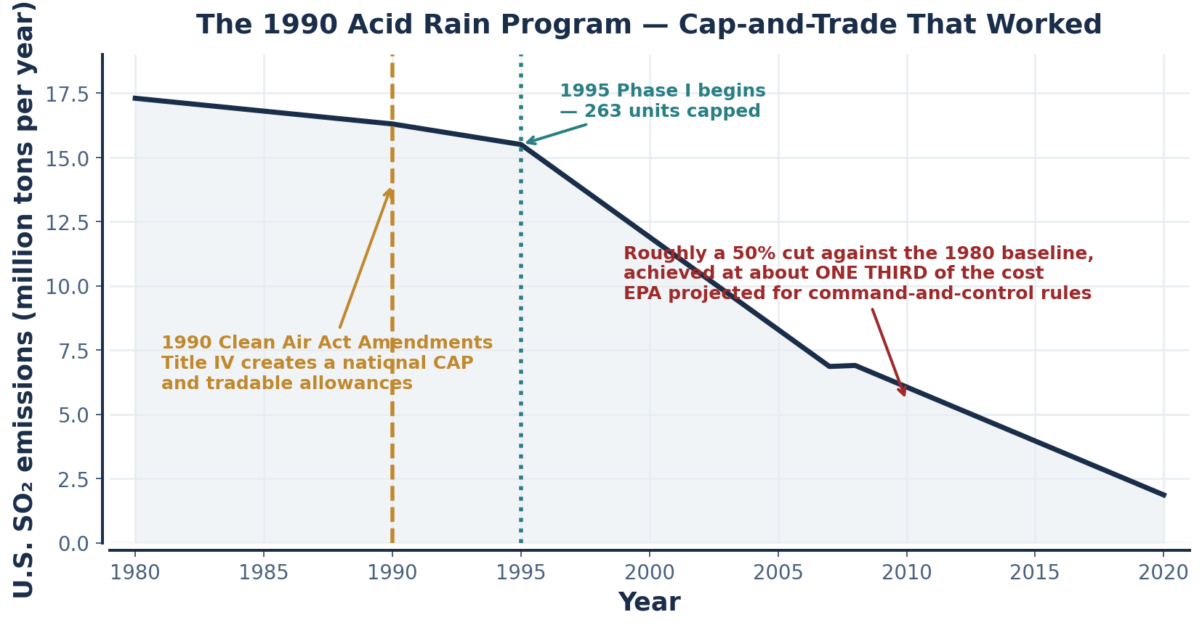
SCENARIO · THE 1990 ACID RAIN PROGRAM
Cap-and-Trade That Worked
1
WHAT MADE IT WORK
One pollutant, one country, about 3,200 regulated units, and CONTINUOUS EMISSIONS MONITORING on every stack. Compliance was verifiable to the ton, so cheating was not an option and the cap was credible.
2
THE RESULT
Roughly a 50% cut against the 1980 baseline, achieved at about ONE THIRD of the cost EPA had projected for equivalent command-and-control rules — because permits flowed to whoever could abate most cheaply.
✦4 WHY CO₂ IS HARDER THAN SO₂
SO₂ damage is REGIONAL and immediate, so the beneficiaries of abatement were the same voters who bore the cost — the game was not a Prisoner's Dilemma at all. CO₂ damage is GLOBAL and deferred, so a country that abates pays the full cost and captures a tiny share of the benefit; defection dominates.
The design feature that made SO₂ work was VERIFIABLE MONITORING inside a single jurisdiction with an enforcing authority. Globally there is no such authority, and emissions are measured by self-report.
INTRO TO MICROECONOMICS | PROF. VELAZQUEZ
MODULE 12: POLICY, PARADOX & HUMAN PERSPECTIVES

Slide 19
SCENARIO · THE SOCIAL COST OF CARBON
Setting the Rate, and Who Pays
SCC ≈ $51 per metric ton (U.S. interim central estimate)
✦5(A) "THE SCC IS DEEPLY UNCERTAIN, SO THE RATE WILL BE WRONG."
EPA's 2023 revision puts the figure far higher — near $190/ton at a 2% discount rate
LARGELY VALID. The estimate depends on a discount rate applied over three centuries, on damage functions calibrated far outside observed temperature ranges, and on an equity weight across countries. Reasonable analysts produce estimates from under $20 to over $300.
BUT the objection does not favor doing nothing: the current implicit price of zero is also a choice, and it is the one estimate we can be confident is wrong. THE DESIGN FIX is a PRICE COLLAR or a CAP with a price floor and ceiling — start at a defensible rate, pre-commit to a scheduled escalation, and let an independent body revise it against realized damage. Uncertainty argues for an adjustable rate, not for no rate.
WORKSHEET BLANK | ANSWER
A $51/ton carbon tax shifts the private MC curve ______ | UP (leftward), by exactly $51 per ton of CO₂, reducing equilibrium Q toward Q*
Revenue could be returned as: (1) (2) (3) | (1) an equal per-capita DIVIDEND; (2) cuts to distorting taxes — payroll or corporate, the 'double dividend'; (3) targeted transition assistance to affected workers and regions
A carbon dividend is ______ because ______ | PROGRESSIVE. The rebate is equal in DOLLARS, but low-income households emit far less in absolute terms, so the flat rebate exceeds their tax bill while high emitters pay in net. Roughly the bottom two thirds come out ahead.
The Coase theorem fails here because transaction costs between ______ parties are ______ | BILLIONS of parties — every emitter and every affected person alive and unborn. Transaction costs are effectively INFINITE, and the future generations who bear most of the damage cannot bargain at all.
✦5(B) "A CARBON TAX IS REGRESSIVE."
VALID ABOUT THE DIRECT BURDEN, and almost entirely fixable. Energy is a larger share of a low-income household's budget, so a uniform per-ton tax takes a larger share of their income. That is a real distributional fact, not a talking point.
BUT regressivity is a property of the tax ALONE, not of the POLICY — and no serious proposal stops at the tax. THE DESIGN FIX is the CARBON DIVIDEND: return the revenue as an equal per-capita payment. Because emissions rise with income less than proportionally, the flat rebate more than covers the tax for most of the distribution, and the package is progressive on net while leaving the marginal incentive to abate fully intact.
Note what this really shows: the efficiency instrument and the equity instrument are SEPARABLE. The price does the allocating; the rebate does the distributing.
INTRO TO MICROECONOMICS | PROF. VELAZQUEZ
MODULE 12: POLICY, PARADOX & HUMAN PERSPECTIVES

Slide 20
3
Tax Incidence & Dynamic Policy
PART
OBJECTIVE Apply the elasticity rule for tax incidence, distinguish who writes the check from who bears the burden, and analyze how time horizons, adjustment costs and path dependence shape what policy can achieve.
INTRO TO MICROECONOMICS | PROF. VELAZQUEZ
MODULE 12: POLICY, PARADOX & HUMAN PERSPECTIVES

Slide 21
PART 3 · THE INCIDENCE RULE
Who Actually Bears a Tax
Consumer's share = Es / (|Ed| + Es) Producer's share = |Ed| / (|Ed| + Es)
THE RULE: the MORE INELASTIC side of the market bears MORE of the burden — because it has fewer ways to escape the price change
1
WHY INELASTICITY MEANS BURDEN
2
STATUTE ≠ INCIDENCE
3
THE 1990 LUXURY TAX
Elasticity measures the ability to WALK AWAY. A buyer who can substitute simply stops buying, forcing the seller to absorb the tax. A buyer who cannot substitute has no threat to make, and pays. The tax lands on whoever has nowhere else to go.
The person who WRITES THE CHECK to the government is not necessarily the person who BEARS THE ECONOMIC BURDEN. Legislatures choose the statutory side; elasticities choose the economic side. They are unrelated.
A 10% tax on boats above $100,000. Yacht demand was ELASTIC — buyers deferred, bought used, or bought abroad. Orders fell about 70%; roughly 25,000 boat-building workers lost jobs. The tax was repealed in 1993.
TAX SCENARIO | DEMAND ELASTICITY | SUPPLY ELASTICITY | WHO BEARS MORE? | HISTORICAL OUTCOME
1990 luxury tax on yachts | Elastic — the purchase can simply be skipped | Elastic | PRODUCERS and their workers | Orders fell ~70%; ~25,000 laid off; repealed 1993
Federal gas tax, 18.4¢/gal (1993) | Inelastic — Americans must drive | Elastic (world oil supply) | CONSUMERS | Consumers paid; modest revenue; little behavior change
Proposed $1/pack cigarette tax | Very inelastic (addiction) | Elastic | CONSUMERS — nearly the full $1 | Reliable revenue; real but modest reduction in smoking, largest among teenagers
Tax on luxury handbags ($10k+) | Elastic — status goods, many substitutes, purchase can be delayed | Inelastic — established brands face production limits and exclusivity constraints | PRODUCERS | Same shape as 1990: revenue disappoints; brands absorb the cost or shift production
INTRO TO MICROECONOMICS | PROF. VELAZQUEZ
MODULE 12: POLICY, PARADOX & HUMAN PERSPECTIVES

Slide 22
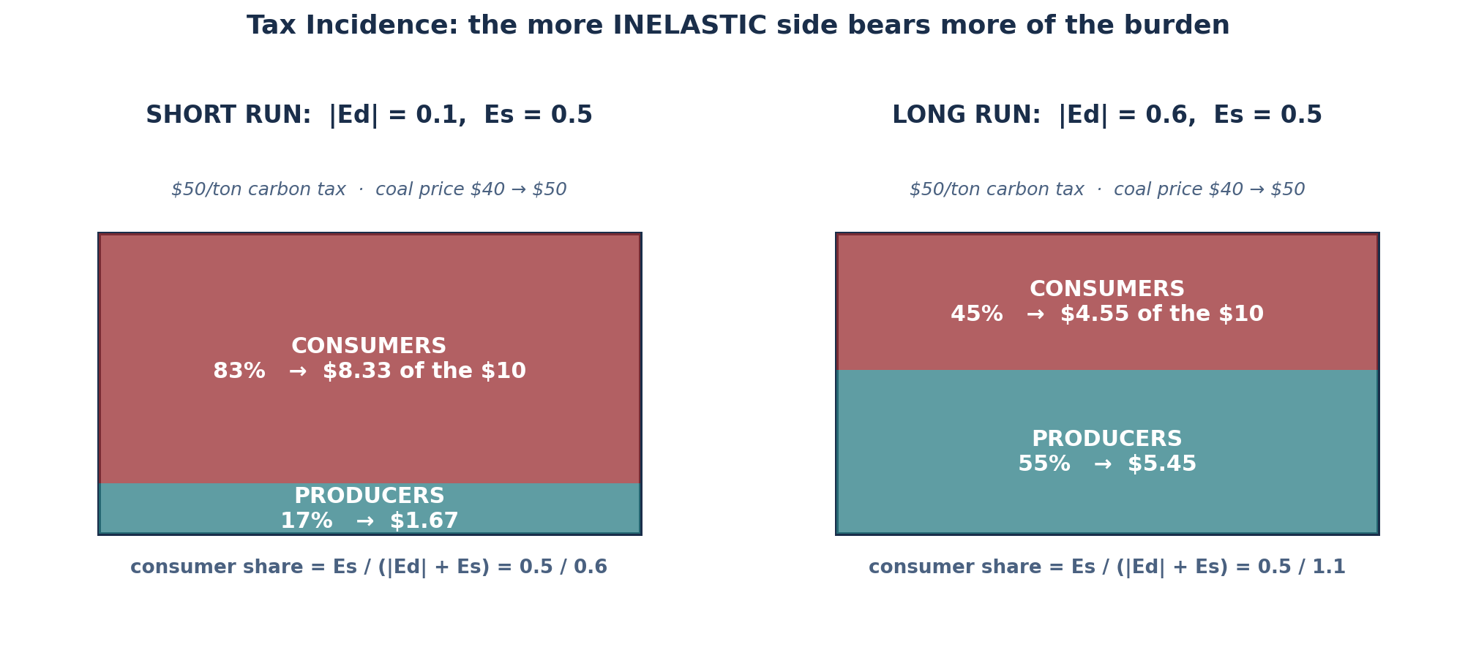
SCENARIO · THE $50/TON CARBON TAX ON COAL
Incidence Now and Incidence Later
QUESTION | ANSWER
Short run: who bears it? | Demand is INELASTIC (|Ed| = 0.1); supply is elastic relative to demand. CONSUMERS bear more: 83% ≈ $8.33 of the $10, producers ≈ $1.67.
Why does demand become more elastic over time? | Capital turns over. Utilities retire coal units and build gas and renewables; industrial boilers are replaced at end of life; long-term supply contracts expire; and grid interconnection makes substitution physically possible. None of this can happen in a year.
As demand becomes elastic, incidence shifts toward ______ | PRODUCERS. At |Ed| = 0.6, the consumer share falls to 45% ($4.55) and producers absorb 55% ($5.45).
Is a carbon tax more or less regressive in the long run? | LESS regressive — twice over. Households escape more of the burden as substitutes appear, AND the low-income households with the fewest short-run options gain the most from having any option at all. The regressivity is largest exactly when the tax is newest.
The behavioral problem in the short run | A visible, immediate, certain cost in exchange for a diffuse, deferred, uncertain benefit — the worst possible framing for a loss-averse, present-biased voter.
INTRO TO MICROECONOMICS | PROF. VELAZQUEZ
MODULE 12: POLICY, PARADOX & HUMAN PERSPECTIVES

Slide 23
PART 3 · DYNAMIC POLICY DESIGN
Time, Adjustment Costs and Path Dependence
TIME IS DYNAMIC
ADJUSTMENT IS COSTLY
PATH DEPENDENCE
Markets adjust slowly at first and more fully later. SHORT RUN: elasticities are low, costs spike, disruption is visible. LONG RUN: behavior adapts, substitutes appear, efficiency rises.
CARBON TAX: after year 1, prices ↑ and emissions ↓ slightly. After year 10, efficiency ↑ and emissions ↓ substantially.
Moving between equilibria imposes real, measurable costs that no comparative-statics diagram shows.
HUMAN CAPITAL: displaced workers lose 20–30% of long-term earnings. PHYSICAL CAPITAL: stranded assets — a coal plant with 25 years of life left. SEARCH AND COORDINATION: matching takes time.
Past decisions CONSTRAIN current options. Today's choices are bounded by yesterday's investments, institutions and infrastructure.
EXAMPLES: employer-based health insurance (a WWII wage-control workaround); fossil-fuel subsidies; car-dependent city form.
TASK 3 — U.S. CARBON POLICY AND PATH DEPENDENCE | ANSWER
1. What past investments created path dependence for today's gas demand? | The 1956 Interstate Highway Act, federally subsidized mortgage lending that favored new suburban construction, single-family zoning, minimum parking requirements, and the near-total absence of intercity rail investment. Together these built a settlement pattern in which driving is not a choice but a precondition of employment.
2. Why is a gas tax MORE REGRESSIVE in car-dependent suburbs than in Manhattan? | Elasticity is a function of available substitutes, and substitutes are a function of the built environment. A Manhattan household faces elastic demand — the subway exists — so it escapes much of the tax. A suburban household faces near-perfectly inelastic demand and bears essentially the whole thing. Path dependence has therefore fixed the incidence decades in advance, and it falls hardest on households that could not afford to live near the transit.
3. Is the IRA's $7,500 EV credit a Pigouvian subsidy, a path-correction policy, or both? | BOTH, and the second is the larger part. As a Pigouvian subsidy it pays for the positive externality of avoided emissions. As path correction it subsidizes the fixed investment — vehicles, charging networks, battery supply chains — that makes future demand elastic. Judged only as a Pigouvian instrument the cost per ton abated looks poor; judged as buying future elasticity, it looks far better.
✦6 1979 AND 2045
American auto plants could not pivot to fuel-efficient cars because their capital was SPECIALIZED — Module 9's fixed factor made real. Engine lines, stamping dies and supplier contracts were sunk in large-car production, and the short run is precisely the period in which they could not be changed. Japanese producers, who had built small cars for a small-car home market, captured about 25% of U.S. sales in four years. Today's equivalent bets — battery and semiconductor fabrication, grid interconnection, the electrician and technician workforce, and the geography of AI data centers and their power supply — will be the specialized capital of 2045, and they will constrain that decade the same way.
INTRO TO MICROECONOMICS | PROF. VELAZQUEZ
MODULE 12: POLICY, PARADOX & HUMAN PERSPECTIVES

Slide 24
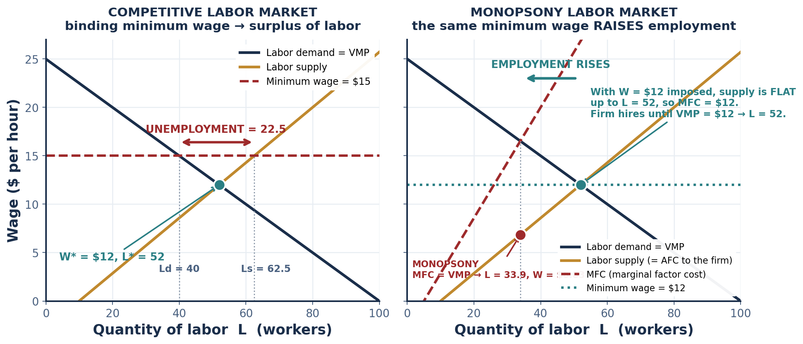
SCENARIO · THE MINIMUM WAGE, 1938–PRESENT
Where Market Structure Changes the Prediction
QUESTION | ANSWER
1. Neoclassical prediction | A minimum wage above W* is a binding price floor: Ld falls to 40, Ls rises to 62.5, and 22.5 workers are unemployed — a labor SURPLUS, exactly the Module 4 price-floor diagram.
2. Why might a minimum wage RAISE employment under monopsony? | A monopsonist hires where MFC = VMP and then pays the wage read DOWN off the supply curve — here L = 33.9 at W = $6.83, well below VMP. Imposing a wage floor makes labor supply FLAT at that wage, so MFC equals the wage rather than exceeding it. The wedge that suppressed hiring disappears, and employment RISES to 52. Card & Krueger (1994) and Dube (2019) find the small-to-zero employment effects this predicts.
3. Path dependence in the $7.25 federal floor, unchanged since July 2009 | Fifteen years of inflation have cut its real value by roughly a third, so the nominal floor now binds almost nowhere; thirty states and many cities legislated their own, producing a patchwork rather than a national standard; and the gap between $7.25 and any politically plausible new figure has grown so large that every proposal now implies a shock rather than an adjustment. Not acting was itself a policy, and it foreclosed the gradual path.
INTRO TO MICROECONOMICS | PROF. VELAZQUEZ
MODULE 12: POLICY, PARADOX & HUMAN PERSPECTIVES

Slide 25
4
Climate Arc, Part 3 — Policy Evaluation
PART
OBJECTIVE Evaluate the full menu of climate policy instruments on efficiency, equity and political feasibility, and design a package that addresses the externality and the distributional injustice together.
INTRO TO MICROECONOMICS | PROF. VELAZQUEZ
MODULE 12: POLICY, PARADOX & HUMAN PERSPECTIVES

Slide 26
PART 4 · THE ARC COMPLETED
Module 6 → Module 8 → Module 12
1
MODULE 6 — THE MECHANISM
2
MODULE 8 — THE INJUSTICE
3
MODULE 12 — THE RESPONSE
We established carbon as a negative externality: the atmosphere is a global common resource, emitters bear none of the marginal damage, and SMC exceeds PMC. The diagnosis.
We documented that the countries least responsible for cumulative emissions are the most vulnerable to the consequences, and that within countries the burden tracks income. The distribution.
We evaluate the instruments. Note that Modules 6 and 8 identify TWO DIFFERENT FAILURES — one of efficiency, one of equity — and no single instrument fixes both.
POLICY INSTRUMENT | EFFICIENCY — does it reach Q*? | EQUITY — who bears the burden? | POLITICAL FEASIBILITY
CARBON TAX (Pigouvian) | HIGH — if the rate equals the SCC | Regressive unless the revenue is recycled | LOW — the cost is visible, salient and attributable to a named politician
CARBON DIVIDEND (tax + rebate) | HIGH — identical efficiency; the rebate is lump-sum and does not blunt the marginal incentive | PROGRESSIVE — an equal rebate exceeds the tax bill for roughly the bottom two thirds | MODERATE — the rebate is visible too, which is the point
CAP-AND-TRADE | HIGH — the market finds the least-cost abatement path to the cap | Depends entirely on permit allocation: grandfathering is a windfall to incumbents, auctioning is not | MODERATE — the price is less salient than a tax, which is why it passes more often
REGULATIONS (CAFE, building codes) | LOWER — a quantity standard rarely lands on Q*, and equalizes nothing across sectors | Varies by design; often hidden in product prices | HIGHER — the cost is diffuse and invisible
PUBLIC INVESTMENT (clean energy R&D) | Targets the POSITIVE externality of innovation rather than the negative one of emissions | Depends on who gets access to the result | HIGH — spending is popular; the benefit is legible and local
JUST TRANSITION FUND | Addresses equity, not efficiency directly | PROGRESSIVE — targets displaced workers and regions | MODERATE — depends on whose district
INTRO TO MICROECONOMICS | PROF. VELAZQUEZ
MODULE 12: POLICY, PARADOX & HUMAN PERSPECTIVES

Slide 27
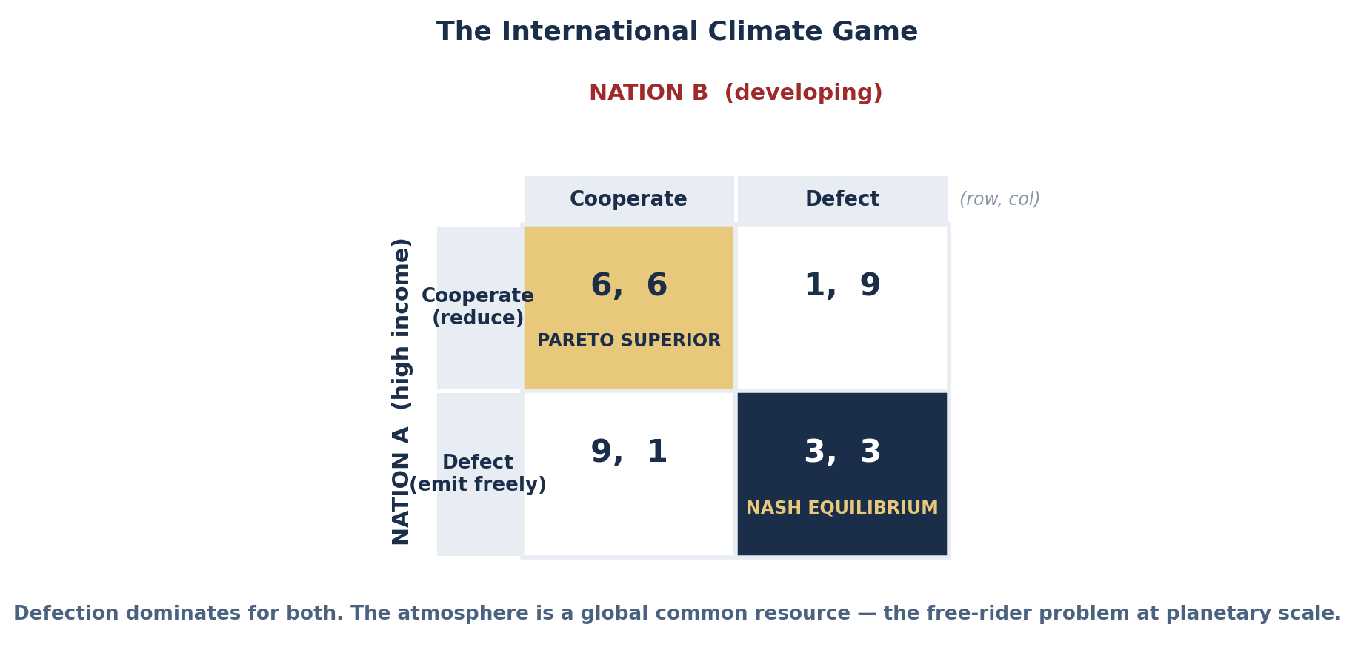
SCENARIO · THE INTERNATIONAL CLIMATE GAME
Two Nations, Asymmetric Stakes
WORKSHEET BLANK | ANSWER
One-shot Nash equilibrium | (Defect, Defect) = (3, 3). Each nation's dominant strategy is to emit: 9 > 6 and 3 > 1.
Pareto-superior outcome | (Cooperate, Cooperate) = (6, 6) — both nations strictly better off, and unreachable without enforcement.
Paris sustains cooperation through: (1) (2) (3) | (1) REPETITION — a five-year ratchet cycle with no end date, so the shadow of the future is long; (2) TRANSPARENCY — a common reporting framework and technical review, which makes defection observable; (3) REPUTATION and domestic mobilization — the only punishment available, since there are no sanctions.
Why might Nation B's calculation differ? | Its cumulative historical emissions are a small fraction of Nation A's, its per-capita emissions are far lower, its abatement cost per unit of GDP is far higher, and it is more physically vulnerable to the warming it did least to cause. Climate justice therefore requires DIFFERENTIATED obligations plus finance and technology transfer — which is what the payoff matrix's symmetry conceals.
✦8 WHAT SUSTAINS COOPERATION, TEMPTATION BY TEMPTATION
HIGH-INCOME NATIONS are tempted by CARBON LEAKAGE — abate at home and the emissions simply relocate, so you pay the cost and capture none of the benefit. The design fix is a BORDER CARBON ADJUSTMENT, which converts a foreign defection into a domestic-market penalty.
DEVELOPING NATIONS are tempted by the fact that abatement competes directly with electrification, industrialization and poverty reduction, at a far higher cost per unit of GDP. The design fix is CLIMATE FINANCE and technology transfer, which lowers their cost of cooperating rather than raising their cost of defecting.
Both are Module 11 moves: change the payoffs, because you cannot change the reasoning.
INTRO TO MICROECONOMICS | PROF. VELAZQUEZ
MODULE 12: POLICY, PARADOX & HUMAN PERSPECTIVES

Slide 28
SECTION II
Human Perspectives — Behavioral, Strategic and Historical
Part 5 · Behavioral economics: Allais, Ellsberg, loss aversion, nudges and administrative burden
Part 6 · Social interaction: public goods games, the ultimatum game, and fairness as an economic force

Slide 29
5
Behavioral Economics
PART
OBJECTIVE Document the systematic ways human choice departs from expected-utility theory, and identify the policy tools — nudges and burden reduction — that follow from those departures.
INTRO TO MICROECONOMICS | PROF. VELAZQUEZ
MODULE 12: POLICY, PARADOX & HUMAN PERSPECTIVES

Slide 30
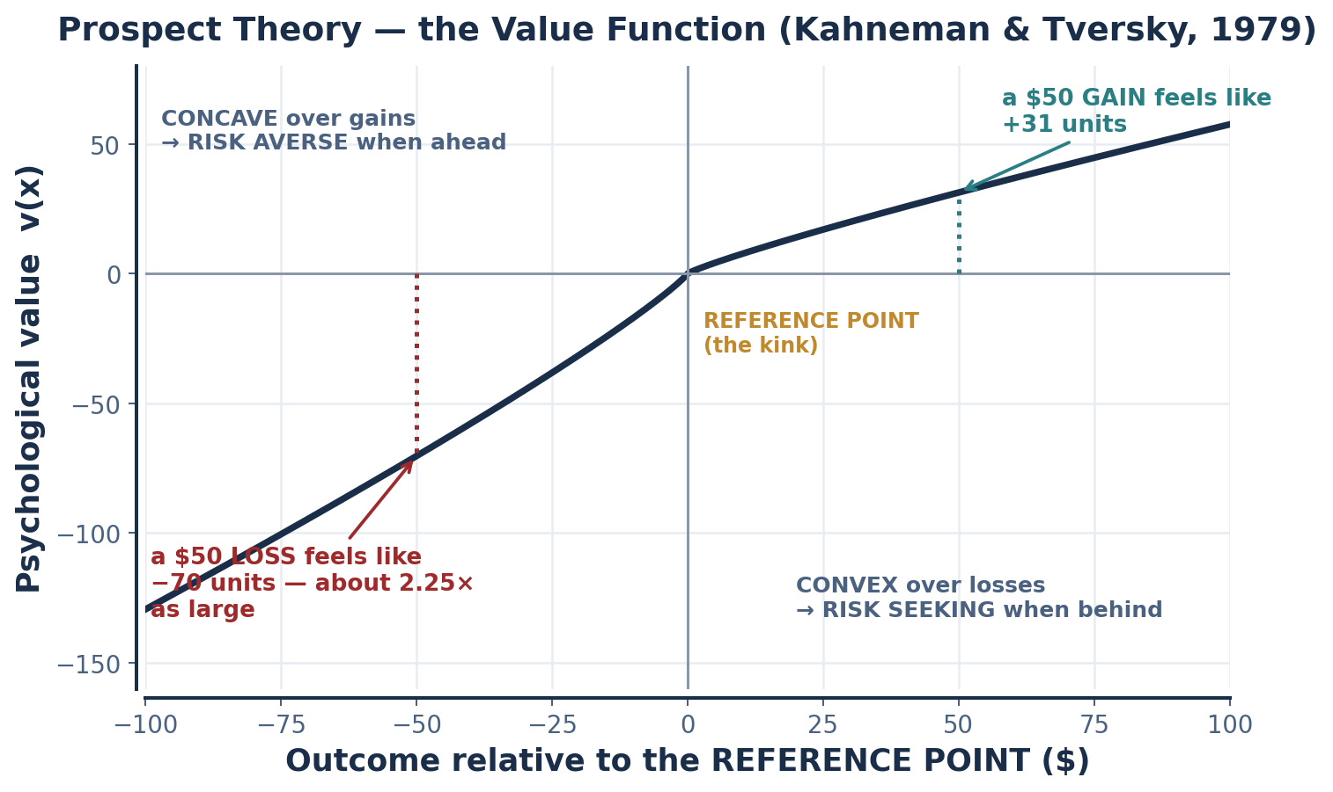
PART 5 · FOUNDATIONS
Bounded Rationality and Loss Aversion
BOUNDED RATIONALITY — Herbert Simon (1955)
LOSS AVERSION — Kahneman & Tversky (1979)
Human rationality is constrained by three things: (1) limited INFORMATION, (2) limited COGNITIVE CAPACITY, and (3) limited TIME.
Simon's claim is not that people are irrational. It is that OPTIMIZING is expensive, so people SATISFICE — they search until they find an option that is good enough against an aspiration level, then stop. Given the cost of search, satisficing is itself the rational procedure.
Losses hurt roughly 2 to 2.5 times more than equivalent gains feel good. The canonical coefficient is λ ≈ 2.25.
The crucial move is that outcomes are evaluated relative to a REFERENCE POINT, not as levels of final wealth. Standard theory has no reference point — which is why it cannot explain why the same $50, framed as a loss avoided or a gain forgone, produces different choices.
THREE COGNITIVE LIMITS | WHAT IT IS | WORKSHEET ANSWER
PRESENT BIAS | We overweight IMMEDIATE costs and rewards against future ones. Plan to save tomorrow; spend today. | Solution: NUDGES — default enrollment into retirement accounts. Participation rises from about 40% to about 90% (Madrian & Shea, 2001).
FRAMING EFFECTS | The same choice, presented differently, produces different choices. | Ground beef '75% LEAN' vs. '25% FAT' — identical product, different preference. 'Carbon tax' vs. 'carbon offset fee' moves acceptance 30–40 points.
OVERCONFIDENCE | Experts systematically overestimate the accuracy of their own models. | Bank risk models in 2007 assigned essentially ZERO probability to a nationwide fall in house prices — an event that had not occurred in their sample.
INTRO TO MICROECONOMICS | PROF. VELAZQUEZ
MODULE 12: POLICY, PARADOX & HUMAN PERSPECTIVES

Slide 31
PART 5 · THE DOCUMENTED DEPARTURES
Six Findings and What Each Breaks
CONCEPT | WHAT IT SHOWS | IMPLICATION FOR STANDARD THEORY | POLICY APPLICATION
ALLAIS PARADOX (1953) | People violate expected utility — they prefer certainty even at slightly lower expected value. Choose A (a sure $1m) over B; then choose D over C, which is inconsistent with that first choice. | The INDEPENDENCE AXIOM of expected utility fails | Insurance is systematically overpriced and still bought; extended warranties
ELLSBERG PARADOX (1961) | People prefer KNOWN risks to UNKNOWN ones — ambiguity aversion — even when expected values are identical. 30 red balls, 60 black-or-yellow in unknown proportion. | Expected utility cannot represent ambiguity avoidance at all | Climate uncertainty is under-acted on; vaccine hesitancy
LOSS AVERSION | Losses are felt about 2.25× as intensely as equivalent gains | Standard theory treats losses and gains symmetrically | Organ donation: opt-OUT countries have consent rates near 90%, opt-IN near 15%
PROSPECT THEORY | Outcomes are evaluated against a REFERENCE POINT, not absolute levels | Utility is not measured from final wealth | A discount framed as 'savings' vs. 'avoiding a price hike'
ENDOWMENT EFFECT (1990) | People value a thing more once they own it. Given a mug, sellers demand far more than buyers will pay for the same mug. | Willingness to accept > willingness to pay — which violates standard preference theory and, note, makes the COASE outcome depend on who holds the right | Property rights in negotiation; the status quo is sticky
PRESENT BIAS / HYPERBOLIC DISCOUNTING | The immediate future is overweighted; preferences REVERSE as the date approaches | Cannot be modeled with a single constant discount rate | Retirement auto-enrollment; commitment devices
WHAT BEHAVIORAL ECONOMICS IS NOT
It is not a claim that people are stupid, and it is not a refutation of the neoclassical model. It is the observation that the deviations are SYSTEMATIC and therefore PREDICTABLE — which means they can be modeled, and which means they can be either exploited or corrected. Thaler's framing is the useful one: economics shifted from NORMATIVE models of how perfectly rational agents SHOULD behave toward POSITIVE models of how people actually DO. Both are still needed: you cannot identify a deviation without a benchmark.
INTRO TO MICROECONOMICS | PROF. VELAZQUEZ
MODULE 12: POLICY, PARADOX & HUMAN PERSPECTIVES

Slide 32
SCENARIO · THE 2008 MORTGAGE CRISIS
Task 4 — Name the Behavioral Failure
ACTOR | BEHAVIORAL FAILURE | MECHANISM | POLICY FIX THAT WAS APPLIED
HOMEBUYERS who signed ARMs they could not afford | PRESENT BIAS + limited financial numeracy + optimism bias | A 1% teaser rate is immediate and salient; the reset to 8% in year three is deferred and abstract. Present bias overweights the first and discounts the second, and borrowers assumed they would refinance out — which required house prices to keep rising. | CFPB (2010): simplified, standardized mortgage disclosure forms — the Know Before You Owe rule; ability-to-repay requirements
RATING AGENCIES that gave AAA to securities that later lost 90% | PRINCIPAL–AGENT + overconfidence in the model | The ISSUER paid for the rating and could shop for the best one. Layered on top, the models assumed regional house-price independence — an assumption that had never been tested against a national decline. | Dodd-Frank (2010): separated ratings from issuer fees, imposed disclosure of rating methodologies and track records
BANK TRADERS who took large short-term risks | MORAL HAZARD + asymmetric compensation | Bonuses were paid on realized short-term profit with NO CLAWBACK if the position later failed. The trader held the upside; the firm and ultimately the taxpayer held the downside — a payoff structure that makes maximum risk the rational choice. | Dodd-Frank: bonus clawback rules; the VOLCKER RULE limiting proprietary trading at insured depositories
READ THE THREE ROWS TOGETHER
Row 1 is a BEHAVIORAL failure — the buyers' own cognition. Rows 2 and 3 are STRUCTURAL failures from Module 7 — principal–agent and moral hazard — where the incentives were misaligned and the behavior was entirely rational given them. The distinction matters for the remedy: a cognitive failure is addressed by changing the CHOICE ARCHITECTURE (clearer forms, better defaults); an incentive failure is addressed by changing the CONTRACT (who pays, who is exposed to the downside). Applying the wrong remedy to the wrong failure is one of the more common ways good policy analysis goes wrong.
INTRO TO MICROECONOMICS | PROF. VELAZQUEZ
MODULE 12: POLICY, PARADOX & HUMAN PERSPECTIVES

Slide 33
SCENARIO · NUDGES AND ADMINISTRATIVE BURDEN
Choice Architecture in Practice
NUDGE — Thaler & Sunstein (2008)
ADMINISTRATIVE BURDEN — the cognitive tax
A change to the DEFAULT OPTION or to the presentation of choices that improves decisions WITHOUT restricting freedom of choice and without changing any economic incentive. Every option remains available at the same price.
Examples: 401(k) auto-enrollment; healthy food at eye level; the energy bill that shows your usage against your neighbors'.
Requiring people to fill out forms, gather documents, and re-certify eligibility is a FRICTION with a real cost in time and cognitive bandwidth. It falls hardest on exactly the people the program targets, because scarcity itself consumes bandwidth (Mullainathan & Shafir, 2013; Module 8, Part 1).
The burden is not a side effect of program design. It is frequently the RATIONING MECHANISM — a way to reduce take-up without a visible eligibility cut.
1. WHY OPT-OUT BEATS OPT-IN, IN LOSS-AVERSION TERMS
2. WHERE REMOVING BURDEN WOULD RAISE WELFARE | EVIDENCE
FAFSA simplification — pre-filling the form from tax data | Roughly +30% college enrollment among assisted low-income students (Bettinger et al., 2012)
SNAP and Medicaid: automatic renewal, shorter re-certification | Behavioral barriers reduce take-up MORE than monetary barriers do (Herd & Moynihan, 2018)
EITC: automatic filing from employer-reported wage data | Roughly one in five eligible households never claims it — worth thousands of dollars a year
Health-plan choice: reducing the number of near-identical options | Consumers overspend $1,000–$2,000 a year on dominated plans (Handel, 2013)
Under opt-IN, enrolling is framed as GIVING UP present income — a loss, weighted by λ ≈ 2.25 — to gain a deferred, abstract benefit. Under opt-OUT, the enrolled state becomes the REFERENCE POINT, so opting out is framed as giving up retirement savings, and inertia now works FOR participation rather than against it.
The choice set is identical and the incentives are identical. Only the reference point moved, and participation goes from roughly 40% to roughly 90%.
THE CRITIQUE YOU SHOULD KNOW
Nudges are cheap and often effective, but their measured effect sizes are modest against structural forces, and they can substitute politically for interventions that would actually change the payoffs. A nudge toward saving does not raise a wage. Use them as a complement to price and income policy, not as a replacement for it.
A benefit that is not claimed is not a benefit.
INTRO TO MICROECONOMICS | PROF. VELAZQUEZ
MODULE 12: POLICY, PARADOX & HUMAN PERSPECTIVES

Slide 34
6
Game Theory & Public Goods Provision
PART
OBJECTIVE Apply Module 11's apparatus to collective action: public goods games, the ultimatum game, and the role of fairness, norms and identity in whether cooperation holds.
INTRO TO MICROECONOMICS | PROF. VELAZQUEZ
MODULE 12: POLICY, PARADOX & HUMAN PERSPECTIVES

Slide 35
PART 6 · TWO PUBLIC GOODS DILEMMAS
The Cooperation Game vs. the Free-Rider Game
DILEMMA 1 — THE COORDINATION GAME (no cost to cooperate)
DILEMMA 2 — THE FREE-RIDER GAME (cooperation is costly)
B: COOPERATE B: FREE-RIDE
A: COOPERATE 5 | 5 4 | 0
A: FREE-RIDE 0 | 4 4 | 4
Payoffs: 5 = the service runs; 4 = an inferior alternative service; 0 = no service.
Cooperating costs nothing here, and (Cooperate, Cooperate) = (5,5) is a Nash equilibrium AND Pareto efficient. But (Free-ride, Free-ride) = (4,4) is ALSO a Nash equilibrium. There are two, and nothing in the payoffs selects between them — this is a COORDINATION problem, not a dilemma of incentives.
B: COOPERATE B: FREE-RIDE
A: COOPERATE 4 | 4 −1 | 5
A: FREE-RIDE 5 | −1 0 | 0
Payoffs: 5 = free-ride on a service someone else funded; 4 = cooperate and share the cost; −1 = pay for the whole service alone; 0 = no service.
Now free-riding strictly dominates for both (5 > 4 and 0 > −1). The unique Nash equilibrium is (0,0), and it is Pareto inferior to (4,4). This is the Prisoner's Dilemma, and it is the structure of every genuine public good.
THE DIFFERENCE IS THE COST OF COOPERATING, AND IT CHANGES THE REMEDY COMPLETELY
In Dilemma 1 the players want the same thing and simply need to find each other. The fix is COMMUNICATION, a focal point, a published schedule, an announcement — cheap, and no compulsion is required.
In Dilemma 2 the players' interests genuinely conflict at the individual level. Communication alone accomplishes nothing, because a promise to contribute is not credible when breaking it is a dominant strategy. The fix has to be ENFORCEMENT — compulsory taxation, a binding assessment, or a sanction that changes the payoffs.
Diagnosing which game you are in is the single most consequential judgment in collective-action policy. Treating a free-rider problem as a coordination problem produces earnest awareness campaigns and no provision.
THE THREE STANDARD SOLUTIONS | WORKSHEET ANSWER
1. Government provision funded by ______ | COMPULSORY TAXATION — it removes the free-ride option from the strategy set
2. Community monitoring and social norms (the ______ approach) | OSTROM's approach — local monitoring, graduated sanctions and cheap conflict resolution can govern a commons without either privatization or a state (Ostrom, 1990)
3. Reduce group size so free-riding is ______ | OBSERVABLE — and therefore punishable by reputation. Anonymity is what makes free-riding safe; small groups destroy it
INTRO TO MICROECONOMICS | PROF. VELAZQUEZ
MODULE 12: POLICY, PARADOX & HUMAN PERSPECTIVES

Slide 36
PART 6 · THE ULTIMATUM GAME
Fairness as an Economic Force
THE GAME
WHY DO PEOPLE REJECT FREE MONEY?
Because the payoff is not only monetary. Three mechanisms are documented, and they are not mutually exclusive:
(1) INEQUITY AVERSION (Fehr & Schmidt, 1999): an unequal outcome carries a real psychological cost, so rejecting a lopsided split can be utility-maximizing.
(2) NEGATIVE RECIPROCITY: punishing an unfair act is itself worth paying for.
(3) REPUTATION: in a repeated world, a person known to accept anything gets offered nothing. Rejection is an investment in not being exploitable, and our intuitions were built for repeated interaction.
Güth et al. (1982) is the origin; the pattern replicates across dozens of countries, though the fair-offer threshold varies with the culture's market integration.
A PROPOSER splits $10. A RESPONDER either ACCEPTS — both get the proposed split — or REJECTS, in which case BOTH get $0.
Rational-agent theory makes a sharp prediction: the responder should accept ANY positive offer, because $1 beats $0. Anticipating that, the proposer should offer $1 and keep $9.
OFFER TO RESPONDER | SHARE | OBSERVED OUTCOME
$5 | 50% | Almost always accepted; the modal offer in most populations
$4 | 40% | Nearly always accepted
$3 | 30% | Accepted most of the time; rejections begin to appear
$2 | 20% | Rejected roughly half the time
$1 | 10% | Rejected the large majority of the time
THE POLICY IMPLICATION
Wage negotiations, tax policy and trade deals often fail not because the arithmetic is wrong but because of FAIRNESS concerns. If workers perceive a wage cut as unfair — even when it is 'rational' given the firm's position — they may strike, and total output falls for everyone. A model that treats fairness as noise will predict agreement where none occurs.
This also explains why identical policies with identical incidence succeed or fail on framing: 'carbon tax' versus 'carbon offset fee' moves acceptance by 30–40 points (Hardisty et al., 2010). Perceived fairness is not a soft consideration bolted onto the economics. It is a determinant of whether the policy exists.
Cooperation depends on incentives, trust, identity and the SOCIAL MEANING of the game.
INTRO TO MICROECONOMICS | PROF. VELAZQUEZ
MODULE 12: POLICY, PARADOX & HUMAN PERSPECTIVES

Slide 37
SCENARIO · MARCUS, RAY & THE SURVEILLANCE CAMERAS
A Public Goods Game with Unequal Stakes
 | RAY: CONTRIBUTE $200 | RAY: FREE-RIDE
MARCUS: CONTRIBUTE $200 | Marcus +$100, Ray +$400 (full funding: $900 of benefit for $400 of cost) | Marcus −$50, Ray +$300 (half funding: $450 of benefit, Marcus pays all of it)
MARCUS: FREE-RIDE | Marcus +$150, Ray +$100 (half funding: $450 of benefit, Ray pays all of it) | Marcus $0, Ray $0 (no cameras)
QUESTION | ANSWER
1. Should both contribute on social-efficiency grounds? | YES. Total benefit $900 against total cost $400 — a net social gain of $500. The project passes a cost–benefit test decisively.
2. Set up the matrix and solve it | MARCUS's dominant strategy is FREE-RIDE (150 > 100 and 0 > −50). RAY's dominant strategy is CONTRIBUTE (400 > 300 and 100 > 0). The Nash equilibrium is (Marcus free-rides, Ray contributes) = ($150, $100). Note that this is NOT a symmetric Prisoner's Dilemma: the good is HALF provided rather than not at all, and total surplus is $250 instead of the efficient $500.
Why the asymmetry matters | Ray's stake is large enough that funding it alone still beats nothing, so he provides — and Marcus, whose stake is smaller, rationally lets him. Olson (1965) called this the EXPLOITATION OF THE GREAT BY THE SMALL: in an unequal group the large beneficiary carries the burden, and the outcome is under-provision rather than zero provision.
3. What norm or mechanism solves it? | A BINDING LOCAL ASSESSMENT — a special-district levy or a business-improvement-district charge — converts the voluntary game into a compulsory one, exactly as taxation does. Real-world analogues: BIDs in Philadelphia and most U.S. downtowns; condominium and HOA dues; Ostrom's irrigation associations, which use local monitoring and graduated sanctions rather than a state.
INTRO TO MICROECONOMICS | PROF. VELAZQUEZ
MODULE 12: POLICY, PARADOX & HUMAN PERSPECTIVES

Slide 38
YOU TRY
Design the Intervention
Pick one market failure from the master table that you have personally encountered.
Name the mechanism precisely — which row, and why that row rather than a neighboring one.
Choose an instrument and state the parameter: the tax rate, the cap, the subsidy, the disclosure rule.
State who bears the burden using the incidence rule, not the statutory obligation.
Name one behavioral obstacle to take-up or compliance, and one design feature that addresses it.
Finally: what is the government failure your intervention risks creating, and how would you detect it?
15 min
INTRO TO MICROECONOMICS | PROF. VELAZQUEZ

Slide 39
SECTION III
Paradoxes, Perspectives & the Course Thesis
Part 7 · Economics's internal critiques: SMD, Solow, Arrow, and the Gödel analogy
· The four classical paradoxes and their resolutions
· Wellbeing beyond GDP: Sen's capabilities approach and the HDI
· The course thesis, returned

Slide 40
7
Paradoxes, Wellbeing & the Course Thesis Returned
PART
OBJECTIVE Encounter economics's own internal critiques, evaluate wellbeing measures beyond GDP, and return to the course question with the full analytical toolkit.
INTRO TO MICROECONOMICS | PROF. VELAZQUEZ
MODULE 12: POLICY, PARADOX & HUMAN PERSPECTIVES

Slide 41
PART 7 · PROBLEM VS. PARADOX
Two Different Kinds of Failure
A PROBLEM
A PARADOX
A situation in which individual incentives lead to outcomes that are inefficient, unstable or socially undesirable.
SOURCES: misaligned incentives, missing or incomplete markets, externalities, strategic behavior, imperfect information.
A problem is a failure IN THE WORLD. The model describes it correctly — that is exactly how we identified it. Everything in Parts 1 through 6 is a problem.
A situation in which the model predicts one outcome, but logical reasoning or empirical evidence shows that outcome cannot hold under the model's OWN assumptions.
A paradox is a failure IN THE THEORY. It shows that the model works at one level but breaks at another, or that its assumptions cannot all be true at once, or that individual logic does not aggregate into the expected collective logic.
You cannot fix a paradox with a policy instrument.
PARADOX / LIMIT | DESCRIPTION | IMPLICATION FOR ECONOMICS
SMD PARADOX (Sonnenschein–Mantel–Debreu, 1972–74) | Even if every individual has well-behaved, rational preferences, AGGREGATE market demand need not be well-behaved. It can take essentially any shape consistent with Walras's law and homogeneity — including multiple equilibria. | Markets may have no unique or stable equilibrium even with fully rational agents. Aggregation, not irrationality, is the problem — which is why 'the representative consumer' is an assumption, not a result.
SOLOW PARADOX (1987) | "You can see the computer age everywhere except in the productivity statistics." Enormous growth in computing capability alongside stagnant measured total factor productivity. | Technology may create value GDP does not capture; or take decades to restructure production; or require complementary institutional change; or redistribute gains rather than create them.
ARROW'S IMPOSSIBILITY THEOREM (1951) | No voting rule can simultaneously satisfy unrestricted domain, Pareto efficiency, independence of irrelevant alternatives and non-dictatorship. | There is no perfect way to aggregate individual preferences into a social choice. 'What society wants' is not a well-defined object, which limits what welfare economics can claim.
GÖDEL'S INCOMPLETENESS (1931) — as ANALOGY | Any sufficiently powerful consistent formal system contains true statements it cannot prove within itself. | Offered here strictly as an analogy, not a theorem about economics: a model may be internally consistent and still be unable to answer questions its own assumptions place outside its reach.
INTRO TO MICROECONOMICS | PROF. VELAZQUEZ
MODULE 12: POLICY, PARADOX & HUMAN PERSPECTIVES

Slide 42
PART 7 · FOUR CLASSICAL PARADOXES
Statement and Resolution
PARADOX | STATEMENT | RESOLUTION — OR ACKNOWLEDGMENT OF ITS LIMITS
PARADOX OF VALUE (Adam Smith, 1776) | Water is essential and nearly free; diamonds are useless and enormously expensive. Why? | RESOLVED, and the resolution founded modern price theory. Price tracks MARGINAL utility, not TOTAL utility. We consume water until the last unit is nearly worthless, so its price is near zero; diamonds are so scarce we never get past the first, extremely valuable, units. The marginal revolution of the 1870s is the answer to Smith's question.
PARADOX OF THRIFT (Keynes, 1936) | Saving is virtuous for an individual; universal saving collapses aggregate demand and can leave everyone poorer. | NOT a logical error but a FALLACY OF COMPOSITION — what is true of the part is not true of the whole, because one person's spending is another's income. It is a macroeconomic result and it has no microeconomic resolution, which is exactly why the second semester exists.
EFFICIENCY–EQUITY TRADEOFF | The most efficient allocation may be deeply unequal, and redistribution creates deadweight loss. | PARTIALLY RESOLVED. Okun's 'leaky bucket' is real but the leak is smaller than once assumed, and the tradeoff is not universal: correcting monopsony, expanding education, or removing occupational barriers raises efficiency AND equity together. The tradeoff binds for pure transfers, not for every equalizing policy.
GROWTH–SUSTAINABILITY PARADOX | GDP growth raises material welfare but may be ecologically incompatible with long-run survival. | UNRESOLVED, and the most consequential open question in the field. The optimistic case is decoupling — growth in value with falling material and carbon throughput, which several wealthy economies have achieved for territorial emissions. The pessimistic case is that this is an accounting artifact of offshoring production. The evidence is genuinely contested.
THE HONEST SUMMARY
Two of these four are resolved, one is partially resolved, and one is open. That distribution is worth noticing: economics is neither the settled science its critics say it pretends to be, nor the failed project they say it is. It has genuinely solved hard problems — the paradox of value stood for a century — and it has genuinely open ones. Knowing which is which is most of what it means to use the field well.
INTRO TO MICROECONOMICS | PROF. VELAZQUEZ
MODULE 12: POLICY, PARADOX & HUMAN PERSPECTIVES

Slide 43
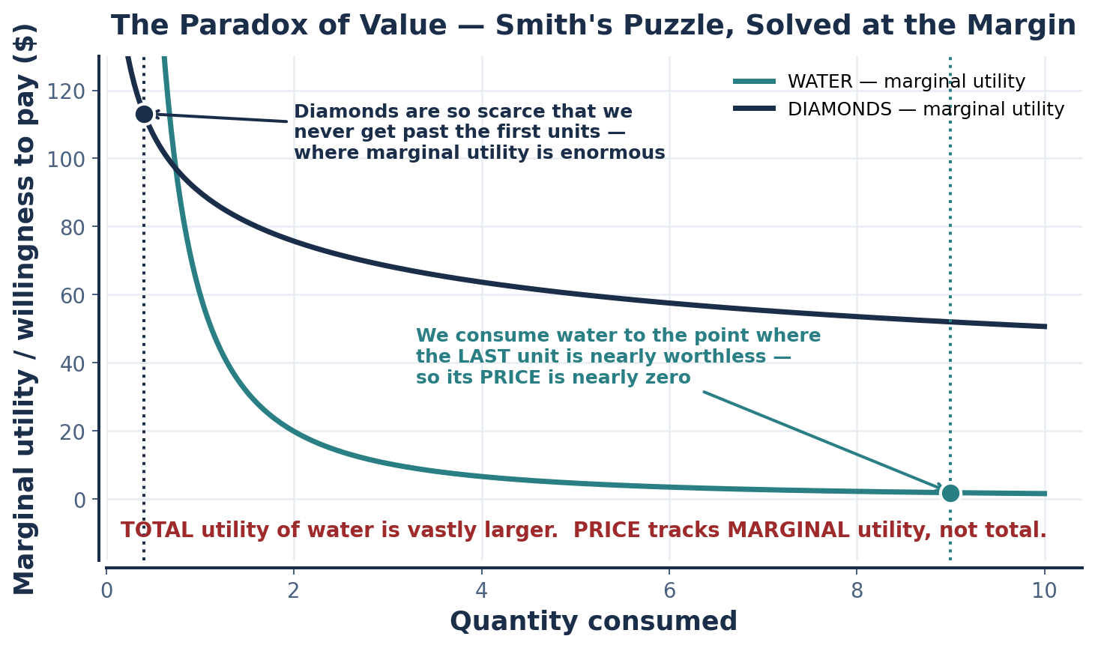
PART 7 · THE PARADOX OF VALUE
Smith's Puzzle, Solved at the Margin
WHY THIS MATTERS BEYOND THE PUZZLE
The resolution establishes the single most transferable idea in the course: DECISIONS ARE MADE AT THE MARGIN, and price carries marginal information only.
Every rule you have learned is an instance. MR = MC. Hire until VMP = wage. Consume until MRS equals the price ratio. Tax at the marginal external cost.
AND THE WARNING IT CARRIES
Because price reflects marginal and not total value, PRICE IS NOT A MEASURE OF IMPORTANCE. Water is cheap and indispensable. Clean air was free and is now scarce. Care work is underpriced and irreplaceable.
A market allocates efficiently at the margin while saying nothing whatever about what matters.
Price ≠ value.
Price = marginal value,
at the current allocation.
INTRO TO MICROECONOMICS | PROF. VELAZQUEZ
MODULE 12: POLICY, PARADOX & HUMAN PERSPECTIVES

Slide 44
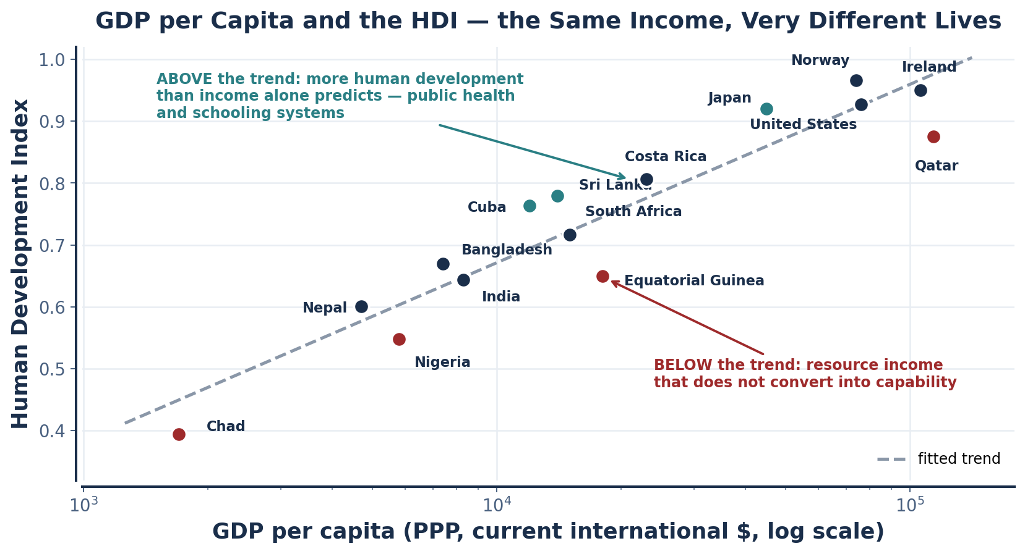
SCENARIO · WELLBEING BEYOND GDP
Sen's Capabilities and the Human Development Index
WORKSHEET BLANK | ANSWER
GDP per capita measures ______ | The market value of final output produced per person — income, and only income that passes through a market
The HDI additionally captures ______ | HEALTH (life expectancy at birth) and EDUCATION (expected and mean years of schooling), combined with income as a geometric mean
A country with high GDP but low HDI has ______ | Income that is not being converted into capability — typically concentrated resource rents, or public services that the income never reaches
Sen: wellbeing is what people are able to DO and BE, not what they ______ | OWN, or consume. The capabilities approach asks about the real FREEDOMS a person has — to be healthy, educated, to participate — not the bundle of goods they hold
Apply to Marcus | His measured GDP contribution is his wages. His actual wellbeing includes job security and predictable hours, health coverage, the safety of his neighborhood, his commute, whether his skills are recognized, and whether he has any real say over his own schedule — none of which appears in the wage.
WHAT GDP WAS BUILT FOR
Kuznets, who built the U.S. national accounts, warned Congress in 1934 that "the welfare of a nation can scarcely be inferred from a measurement of national income." GDP measures market output. It was never a measure of wellbeing.
INTRO TO MICROECONOMICS | PROF. VELAZQUEZ
MODULE 12: POLICY, PARADOX & HUMAN PERSPECTIVES

Slide 45
PART 7 · THE CLOSING CODA
What This Course Cannot See
1
IT CANNOT TELL YOU WHAT TO VALUE
2
IT CANNOT RELIABLY AGGREGATE
3
IT CANNOT MEASURE EVERYTHING IT NEEDS
Every efficiency result takes preferences and the initial distribution of endowments as GIVEN. Change either and the 'efficient' outcome changes. Economics can tell you the cost of a goal; it cannot tell you the goal. Arrow's theorem shows that even aggregating your goals is not straightforward.
SMD: individual rationality does not deliver a well-behaved market. The paradox of thrift: individually prudent saving can be collectively ruinous. The Prisoner's Dilemma: individually rational play produces a collectively irrational outcome. The pattern repeats at every scale.
The Solow paradox is at bottom a measurement problem. So is the social cost of carbon. So is the value of unpaid care work, which is roughly a fifth of GDP-equivalent activity and appears nowhere in GDP. What is not measured is not managed — and, more dangerously, is treated as zero.
THE TRANSITION TO MACROECONOMICS
CREATIVE DESTRUCTION — SCHUMPETER (1942)
Three questions micro cannot answer well, and what macro adds:
(1) WHY DO RECESSIONS HAPPEN, and why does unemployment persist? Micro has no theory of aggregate demand — needs the multiplier, sticky prices, and monetary policy.
(2) WHAT DETERMINES THE PRICE LEVEL and inflation? Micro determines relative prices only — needs a monetary system and expectations.
(3) WHY DO SOME COUNTRIES GROW FASTER for a century? Micro takes technology as given — needs growth accounting and endogenous innovation.
Progress within an economy comes from the destruction of old technologies, firms, jobs and institutions by new ones. Schumpeter's point was uncomfortable and remains so: the mechanism of growth and the mechanism of disruption are THE SAME MECHANISM. You cannot have one without the other, and the people who bear the destruction are rarely the people who capture the creation — which is Module 8's argument arriving from the other direction.
Several scholars — Olson (1982), Aghion & Howitt (1992), Beinhocker (2006) — argue that creative destruction must also be applied to ECONOMIC THEORY ITSELF.
Learn the rules of the game so that you can think critically about when they are being broken —
and when they MUST be.
Rules of thumb are heuristics, not laws. Internalize them; then notice where they fail.
INTRO TO MICROECONOMICS | PROF. VELAZQUEZ
MODULE 12: POLICY, PARADOX & HUMAN PERSPECTIVES

Slide 46
PART 7 · THE COURSE THESIS
Returned to You
THE QUESTION, AS IT WAS POSED IN MODULE 1
"Why do markets sometimes fail to allocate resources in ways that promote human flourishing — and what, if anything, should be done about it?"
You answered it once with no tools. You now have supply and demand, elasticity, the surplus framework, factor markets, cost curves, MR = MC, market structure, game theory, welfare economics and behavioral economics — and an arc of evidence running from Mesopotamian grain records to the climate emergency.
THE FINAL STATEMENT — complete it in your own words
"Markets are powerful institutions for ______________________________ , but they systematically fail when ______________________________ — and the most important of these failures for human wellbeing is ______________________________ because ______________________________ ."
WHAT A STRONG THESIS DOES | WHAT A WEAK ONE DOES
Names a SPECIFIC failure from the taxonomy and identifies its mechanism | Says 'markets sometimes fail' without naming which failure or why
Uses at least one case study from the course as evidence, with numbers | Asserts a position and offers illustration rather than evidence
Matches an instrument to the mechanism and states its parameter | Calls for 'more regulation' or 'less regulation' in the abstract
States the incidence — who bears the cost — and defends it | Ignores distribution, or assumes the statutory payer is the burdened party
Acknowledges the strongest objection and answers it | Treats the opposing view as unserious
💡9 FINAL COURSE SYNTHESIS
(a) Which single module best explains Marcus's situation? (b) Which single market failure most directly shapes his outcomes? (c) Design ONE intervention: use the surplus framework to show it improves efficiency, the behavioral framework to show it will actually work, and the Lorenz/Gini framework from Module 8 to show it reduces inequality. That is what real policy analysis looks like.
INTRO TO MICROECONOMICS | PROF. VELAZQUEZ
MODULE 12: POLICY, PARADOX & HUMAN PERSPECTIVES

Slide 47
YOU TRY
Exit Ticket — and the End of the Course
Write your final course thesis in the four blanks. One paragraph, specific, with at least one number.
Name the ONE concept from these twelve modules with the most real-world explanatory power — and defend it with a case.
Name the ONE with the most serious limitation — and defend that too.
Then answer ✦10 in three to five sentences: why do markets sometimes fail to promote human flourishing, and what should be done?
This is the argument the whole course has been building toward. Take it seriously; it is the only question on the list that has no answer key.
20 min
INTRO TO MICROECONOMICS | PROF. VELAZQUEZ

Slide 48
MODULE 12
Sources & Further Reading
Pigou, A. C. (1920). The economics of welfare. Macmillan.
Coase, R. H. (1960). The problem of social cost. Journal of Law and Economics, 3, 1–44.
Samuelson, P. A. (1954). The pure theory of public expenditure. Review of Economics and Statistics, 36(4), 387–389.
Hardin, G. (1968). The tragedy of the commons. Science, 162(3859), 1243–1248.
Ostrom, E. (1990). Governing the commons. Cambridge University Press.
Olson, M. (1965). The logic of collective action. Harvard University Press.
Schmalensee, R., & Stavins, R. N. (2013). The SO₂ allowance trading system. Journal of Economic Perspectives, 27(1), 103–122.
Card, D., & Krueger, A. B. (1994). Minimum wages and employment. American Economic Review, 84(4), 772–793.
Cengiz, D., Dube, A., Lindner, A., & Zipperer, B. (2019). The effect of minimum wages on low-wage jobs. QJE, 134(3), 1405–1454.
Simon, H. A. (1955). A behavioral model of rational choice. QJE, 69(1), 99–118.
Kahneman, D., & Tversky, A. (1979). Prospect theory. Econometrica, 47(2), 263–291.
Kahneman, D., Knetsch, J., & Thaler, R. (1990). Experimental tests of the endowment effect. JPE, 98(6), 1325–1348.
Thaler, R. H., & Sunstein, C. R. (2008). Nudge. Yale University Press.
Herd, P., & Moynihan, D. (2018). Administrative burden. Russell Sage Foundation.
Güth, W., Schmittberger, R., & Schwarze, B. (1982). An experimental analysis of ultimatum bargaining. JEBO, 3(4), 367–388.
Fehr, E., & Schmidt, K. M. (1999). A theory of fairness, competition and cooperation. QJE, 114(3), 817–868.
Arrow, K. J. (1951). Social choice and individual values. Wiley.
Sen, A. (1999). Development as freedom. Knopf.
Schumpeter, J. A. (1942). Capitalism, socialism and democracy. Harper.
INTRO TO MICROECONOMICS | PROF. VELAZQUEZ
MODULE 12: POLICY, PARADOX & HUMAN PERSPECTIVES

